Slide 1
Database Mid Project University Learning Management System
Presented By: Muhammad Nazir (2021-CS-8)

Slide 2
Outlines
Problem Statement
Introduction
Database Design
Activity Diagram
Limitations
Future Work
Conclusion
Target Audience

Slide 3
Problem Statement
The problem addressed by this project is the difficulty instructors face in manually assessing students, which can be a time-consuming and error-prone process. This project aims to address this problem by developing a desktop application that performs CRUD operations on a database schema. The system also generates PDF reports to provide useful information to instructors. The project seeks to demonstrate the benefits of using databases to manage large amounts of data efficiently and securely, specifically in the context of managing student assessment data.

Slide 4
Introduction
The topic at hand is the use of databases in real-world scenarios, specifically in the context of managing student assessments and related data.
Currently, instructors often have to manage student assessment data manually, which can be a difficult and time-consuming task.

Slide 5
Introduction
This project aims to create a desktop application that can automate the management of student assessment data using a database schema.
The database schema is designed to efficiently and securely store and manage student assessment data, including results, attendance, and personal information.

Slide 6
Introduction
In addition to managing data, the system can also generate PDF reports that provide instructors with useful information about student performance.
By demonstrating the use and benefits of databases in managing large amounts of data efficiently and securely, this project aims to showcase the real-world applications of this technology.

Slide 7
Target Audience
The target audience for the University Learning Management System are the teachers that were evaluating the students manually. This will help instructors to manage students, clo's ,rubric's, rubric level's, asessment's, assessment components's data.

Slide 8
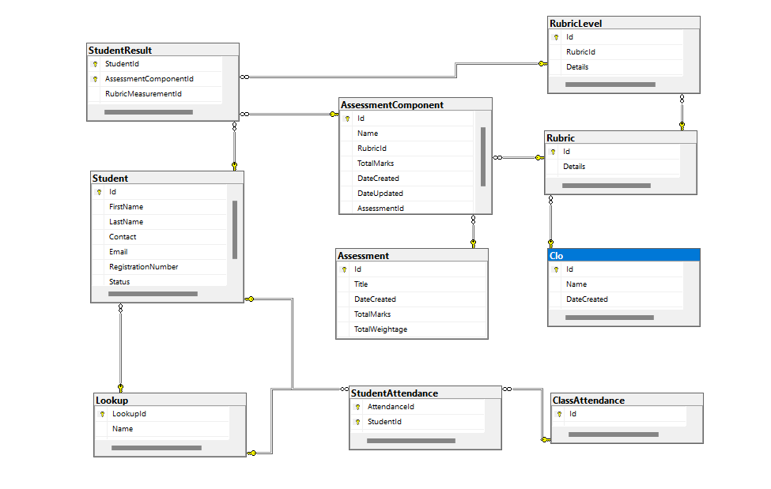
Database Design

Slide 9
Activity Flow Diagrams

Slide 10
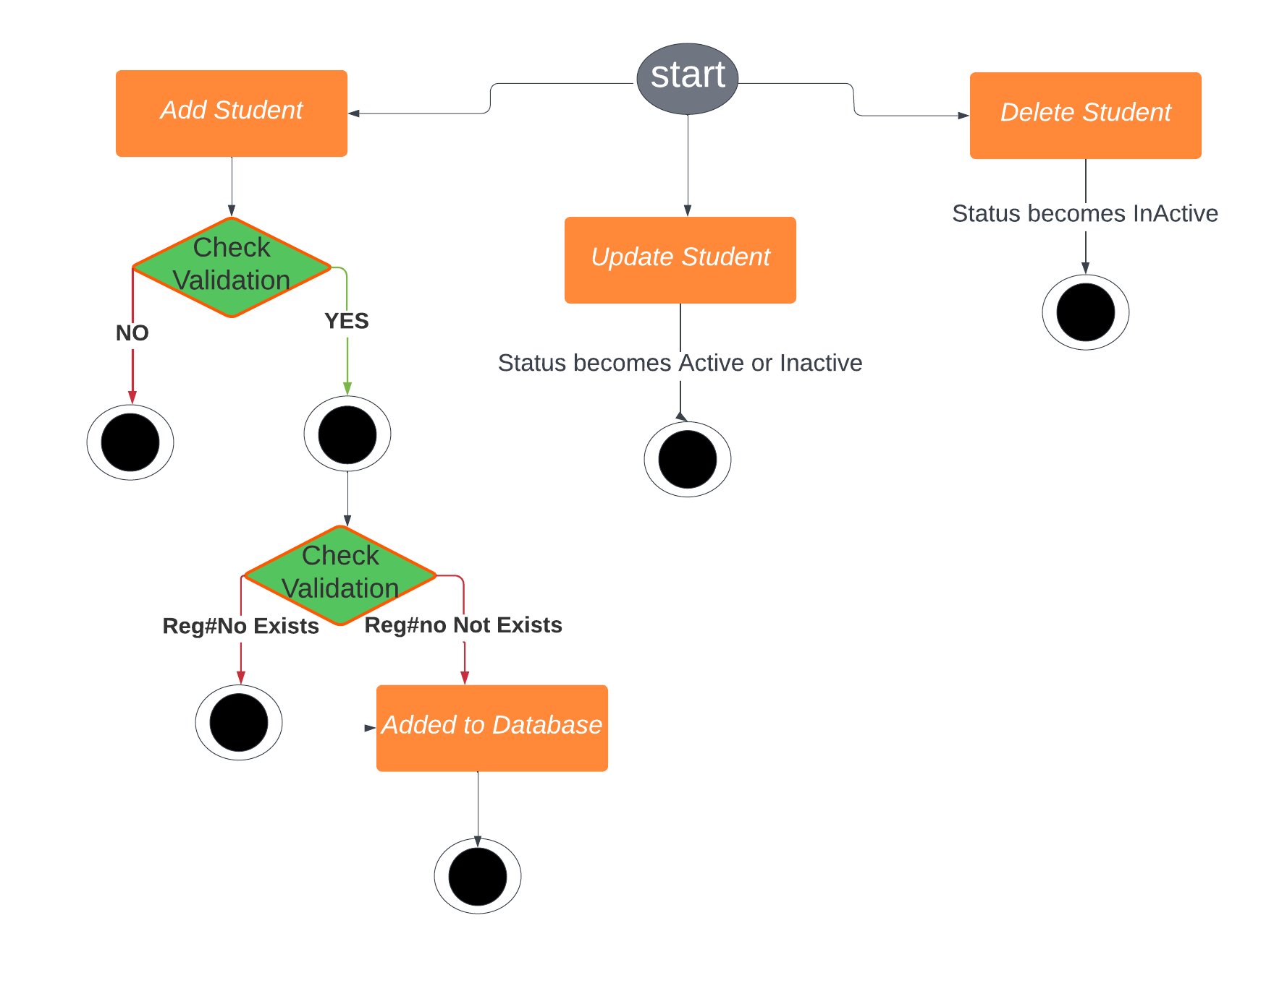
Manage Students

Slide 11
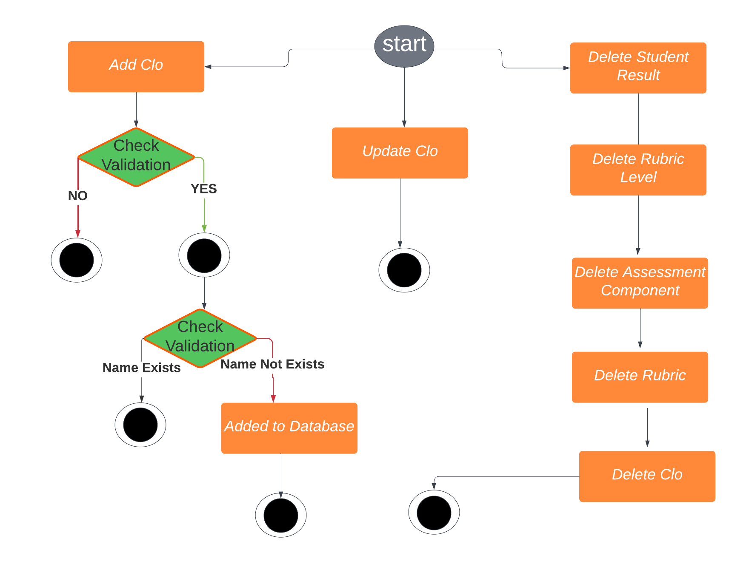
Manage Clo's

Slide 12
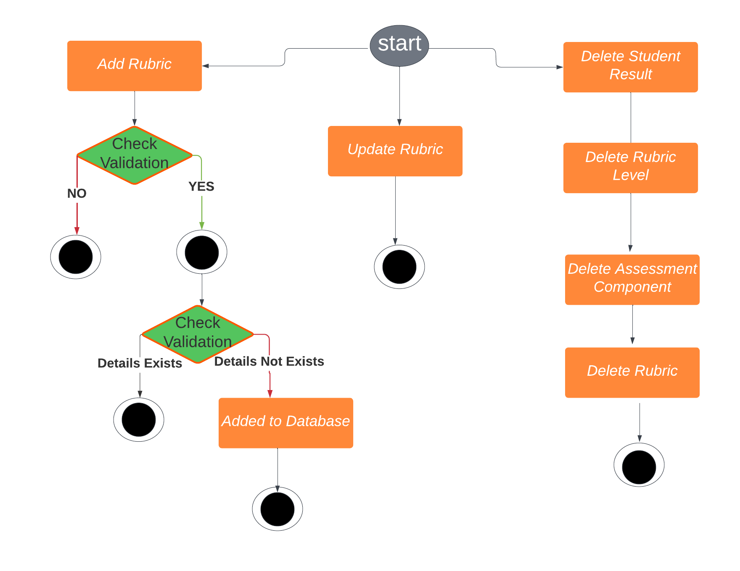
Manage Rubrics

Slide 13
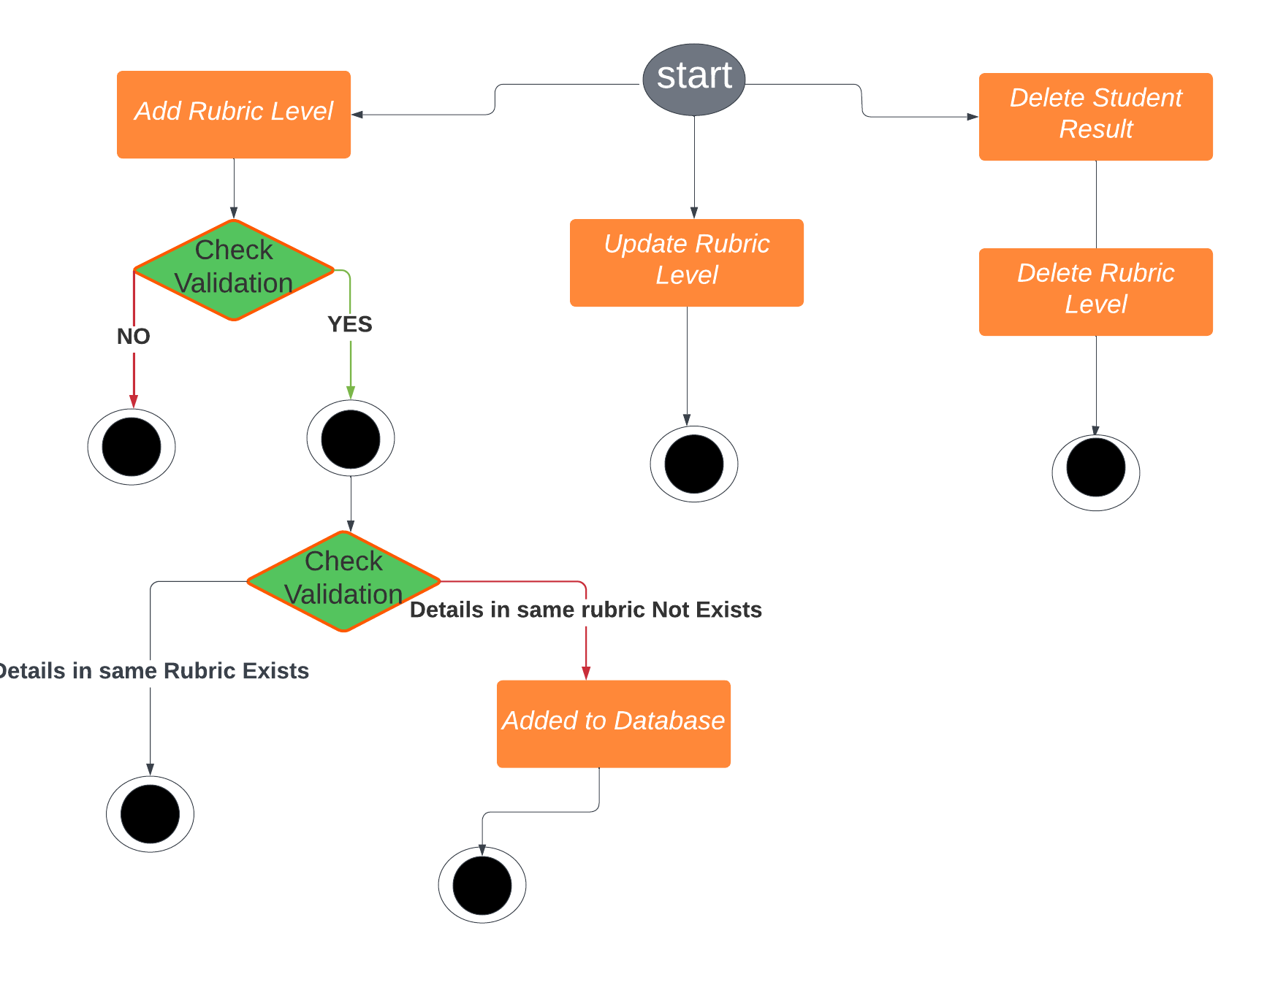
Manage Rubric Levels

Slide 14
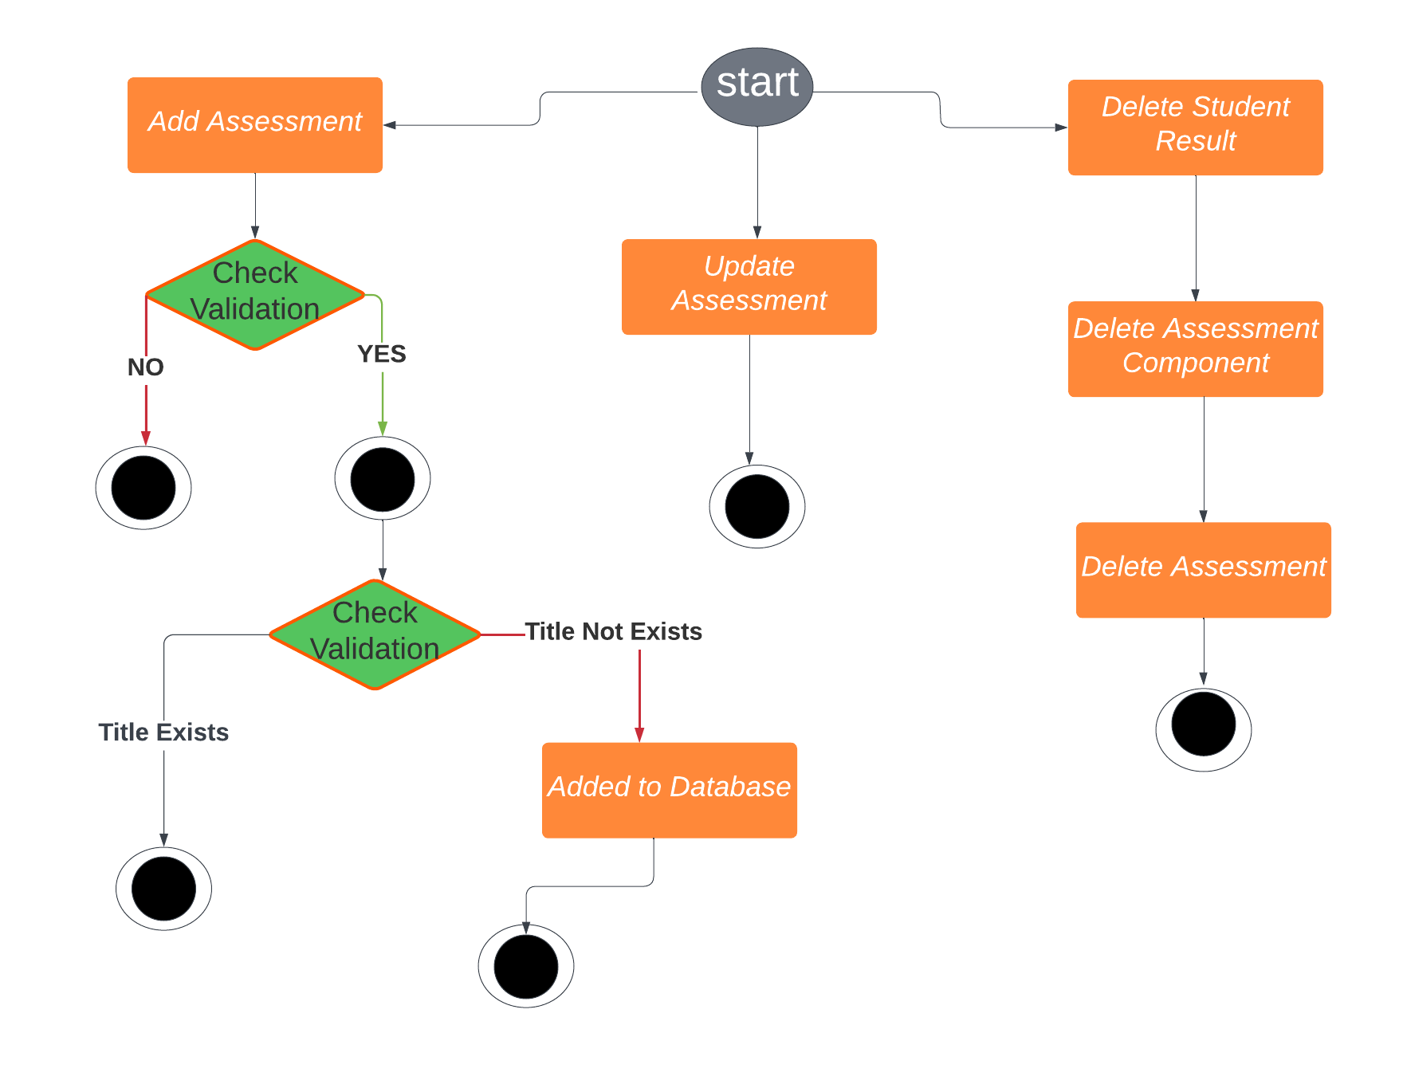
Manage Assessments

Slide 15
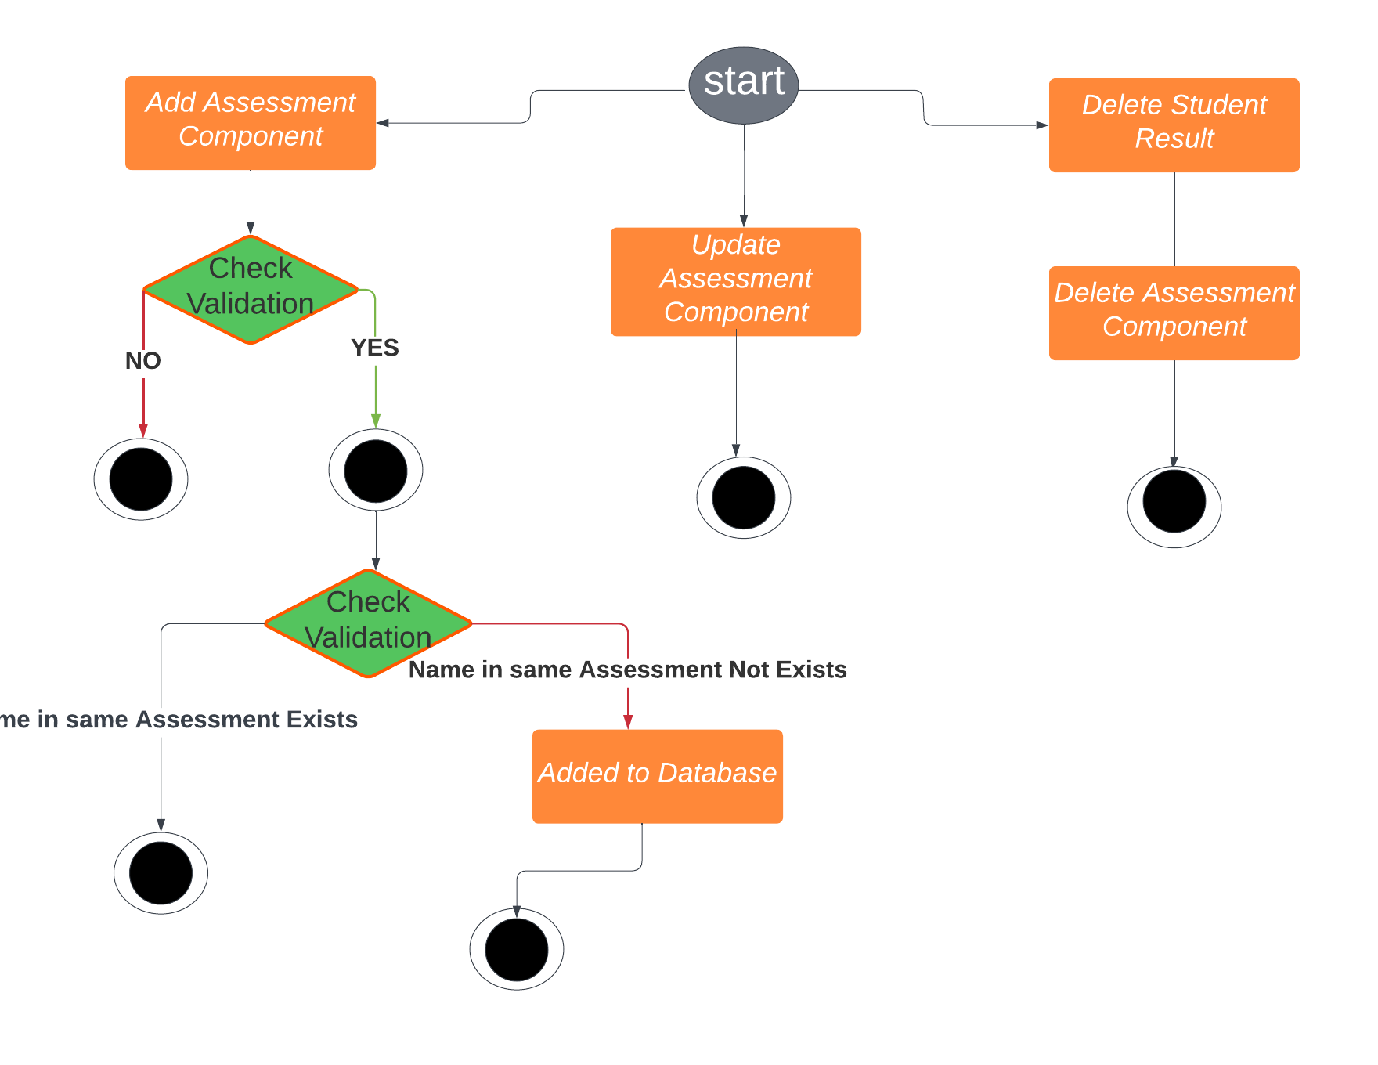
Manage Assessment Components

Slide 16
Limitations
The concepts of Object Oriented programming is not used.
This application is for single user and has not Sign Up, Sign In functionality.
The application accepts only those phone numbers that are affiliated with Pakistan.
I have generated monthly attendance report tat shows the count but it is not up to the mark.

Slide 17
Future Work
I will make signIn, signUp application in future so that the application can be used for many users.
I will change that the system accepts all formats of contact number no matter that the phone number is belongs to which country.
I will make attendance report in such a way that we can see the status of students in a proper manner.
I will apply all the Object Oriented Programming Features.

Slide 18
Conclusion
This project aims to address the difficulties faced by instructors in manually assessing student performance.
The proposed solution is a desktop application that performs CRUD operations on a database schema.
The system generates PDF reports that provide useful information to the instructors.
The system aims to replace human labor and increase efficiency by automating the process of student assessment.

